Slide 1

Ergonomics Sembreak Week 1

Slide 2
What had been discussed last week
Work on current framework first, if time allows, then only proceed to time-continuous assessment.
Decide to use Microsoft Kinect RGBD camera instead of Vicon camera
Review again the framework

Slide 3
Timeline
Content | Date | Progress
Learning Basics of Deep Learning | Sep 2022 | Done
Installing Alphapose/Openpose | Sep-Oct 2022 | Done
Learning Ergonomics Basics | Oct-Nov 2022 | Done
Forming a Framework of Time Continuous Cumulative Fatigue
Preparing for Final Exam | Nov-Dec 2022 | Done
Review the Time Continuous Cumulative Fatigue Framework | Dec 2022
Trying to Extract Coordinates Using Alphapose/Openpose | Dec 2022
Adding on a Cumulative Fatigue Assessment using Alphapose/Openpose with Python | Jan-Mar 2023
Writing a Technical Report for our Research | Mar 2023

Slide 4
Technical Framework of CD
Motion Capture
Data
Pre-processing
Cumulative Damage
Probability of Risk

Slide 5


Motion Capture
x
y
Normal Camera
3D Coordinates
Openpose
z
Low Back Flexion $θ_{l}$
Arm Elevation $θ_{a}$
Accuracy
Microsoft Kinect RGBD
Ground Truth

Slide 6


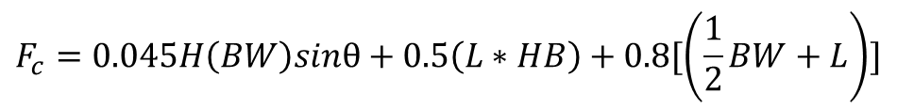
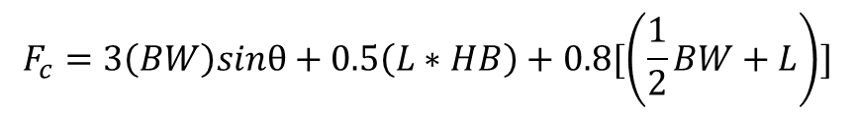
Data Pre-processing (Low Back)
$$F_{c}=3\left(BW\right)sinθ+0.5\left(L∗HB\right)+0.8[\left(\frac{1}{2}BW+L\right)]$$
x, y, z, $θ_{l}$, $θ_{a}$
Lever Arm
Moments + Forces
Revised version
Load’s Weight
$$F_{c}=0.045H\left(BW\right)sinθ+0.5\left(L∗HB\right)+0.8[\left(\frac{1}{2}BW+L\right)]$$
https://health.usf.edu/publichealth/tbernard/~/media/D7F7CFCBC5EF43EBB9A23E592BC84411.ashx
https://www.researchgate.net/publication/40785995_A_revised_back_compressive_force_estimation_model_for_ergonomic_evaluation_of_lifting_tasks
$$σ_{x}^{peak}=\frac{F_{c}^{peak}}{A}$$

Slide 7










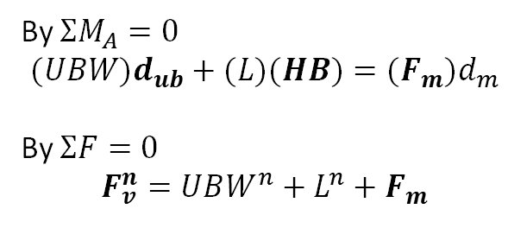



Data Pre-processing (Low Back)
$$\hat{n}$$
$$\hat{t}$$
$$L$$
$$F_{m}$$
$$UBW$$
$$θ$$
$$P_{L}$$
$$F_{v}$$
$$F_{m}^{′}$$
$$F_{v}^{′}$$
$$P_{ub}$$
$$L$$
A
$$HB$$
A
By $ΣM_{A}=0$
$$(UBW)d_{ub}+(L)(HB)={(F}_{m})d_{m}$$
By $ΣF=0$
$$F_{v}^{n}=UBW^{n}+L^{n}+F_{m}$$

Slide 8



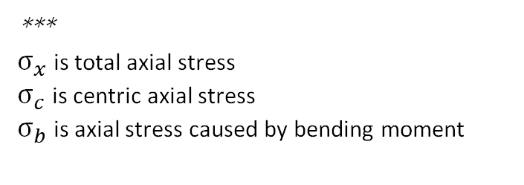

Data Pre-processing (Shoulder)
x, y, z, $θ_{l}$, $θ_{a}$
Lever Arm
$$σ_{c}=\frac{F_{m}}{A}$$
Moments + Forces
$$σ_{x}=σ_{c}+σ_{b}$$
Load’s Weight
$σ_{b}=\frac{M_{L}y}{I}$+ $\frac{M_{ub}y}{I}$
***
$σ_{x}$ is total axial stress
$σ_{c}$ is centric axial stress
$σ_{b}$ is axial stress caused by bending moment
https://health.usf.edu/publichealth/tbernard/~/media/D7F7CFCBC5EF43EBB9A23E592BC84411.ashx

Slide 9






Data Pre-processing (Shoulder)
$$F_{m}$$
$$F_{x}$$
A
$$F_{y}$$
$$W_{s}$$
$$L$$
$$P_{L}$$
$$F_{m}$$
or
$$M$$
$$F_{x}$$
A
$$F_{y}$$
$$W_{s}$$
$$L$$

Slide 10
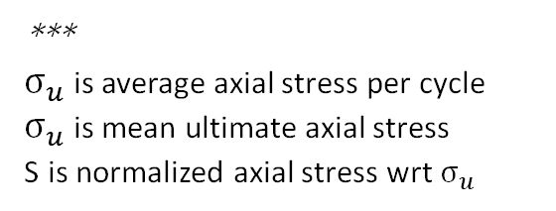



Cumulative Damage
Low Back
$$N=902416∗e^{−0.162∗S}$$
$$S=\frac{σ_{x}^{peak}}{σ_{u}^{avg}}$$
CD = DPC * Number of Repetitions
Shoulder
$$S=101.25−14.83\log{N}$$
***
$σ_{u}$ is average axial stress per cycle
$σ_{u}$ is mean ultimate axial stress
S is normalized axial stress wrt $σ_{u}$

Slide 11
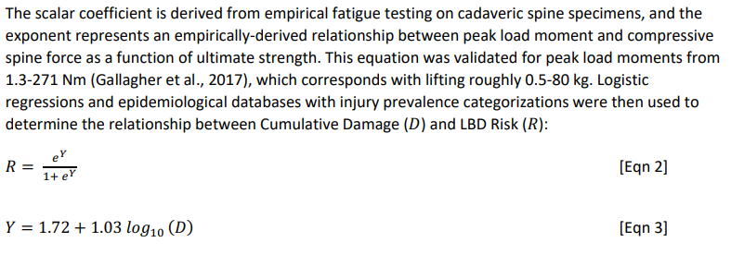
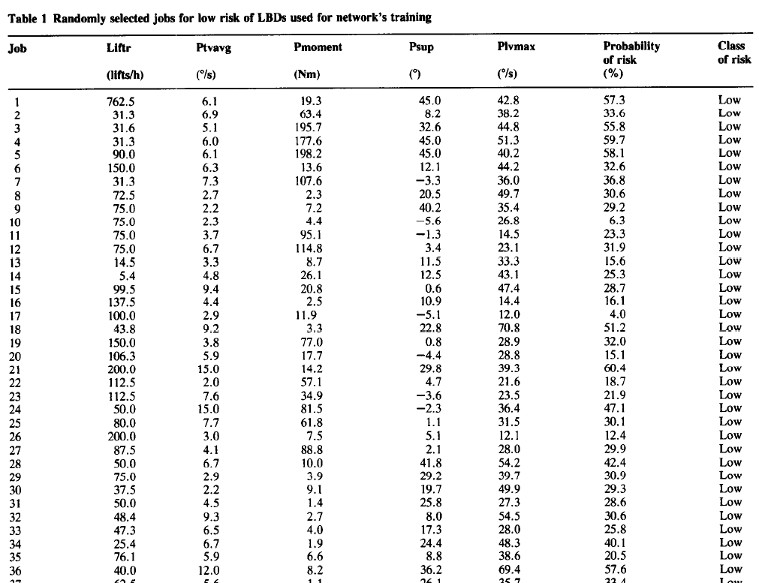
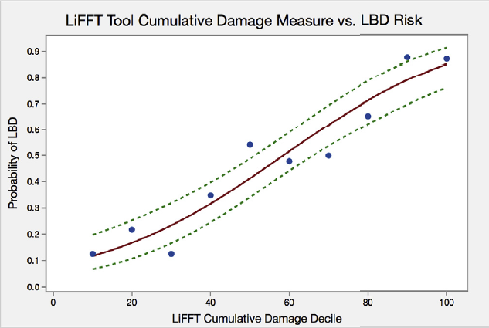
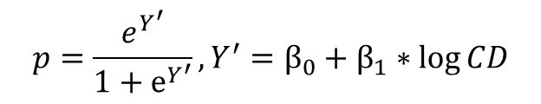
Probability of Risk
$$p=\frac{e^{Y^{′}}}{1+e^{Y^{′}}}, Y^{′}=β_{0}+β_{1}∗\log{CD}$$

Slide 12
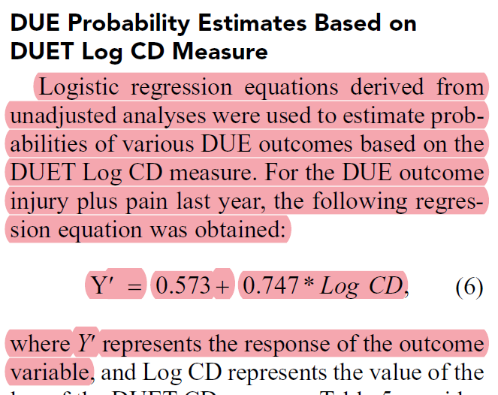
Probability of Risk
$$p=\frac{e^{Y^{′}}}{1+e^{Y^{′}}}, Y^{′}=β_{0}+β_{1}∗\log{CD}$$

Slide 13


Validation
$$Odds Ratio, OR=\frac{p}{1−p}$$
***
(a) if OR < 1 :
less likely to happen LBD
(b) if OR = 1:
LBD is independent to CD
(c) if OR > 1:
more likely to happen LBD
if OR > 2.43: HIGH risk
if OR < 2.43: LOW risk
Cutoff point, CD = 0.03
Compare to database (ground truths)

Slide 14
Automation in Construction
Problem Statement: To evaluate the impact of semi-automated work systems (self-levelling pallet) on health and productivity in the construction industry. (fully-automated is too challenging)
IMU + 3DSPP Low Back Compression Force
Higher Risk
Traditional
Motion Capture
Data Pre-processing
Cumulative Damage
Lower Productivity
40% Lower Risk
Semi-automated
Motion Capture
Data Pre-processing
Cumulative Damage
10% Higher Productivity
Conclusion: Repeatedly lowering down the back without carrying heavy loads is also harmful Safer and more productive to work with the assistance of machine

Slide 15
Analysis of Relationships between Body Load and Training, Work Methods, and Work Rate
Problem Statement: How does experience workers load their joints and adjust their posture to work more safely and more efficiently compared to apprentices
Novice
Safety
1-year experience
IMU+3DSPP
Lift Type
Hypothesis Test
3-year experience
Journeyman
Efficiency
Conclusion: Repeatedly lowering down the back without carrying heavy loads is also harmful Safer and more productive to work with the assistance of machine

Slide 16
Analysis of Relationships between Body Load and Training, Work Methods, and Work Rate
Problem Statement: How does experience workers load their joints and adjust their posture to work more safely and more efficiently compared to apprentices
Novice
Safety
1-year experience
IMU+3DSPP
Lift Type
Hypothesis Test
3-year experience
Journeyman
Efficiency
Conclusion: Repeatedly lowering down the back without carrying heavy loads is also harmful Safer and more productive to work with the assistance of machine

Slide 17
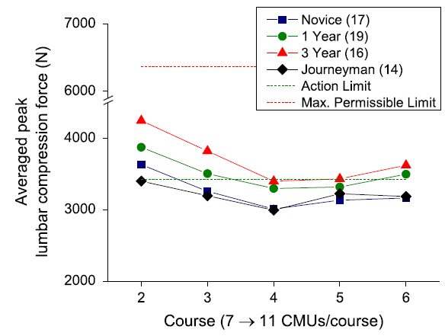
Analysis of Relationships between Body Load and Training, Work Methods, and Work Rate
All has lowest lumbar compression force at course 4

Slide 18
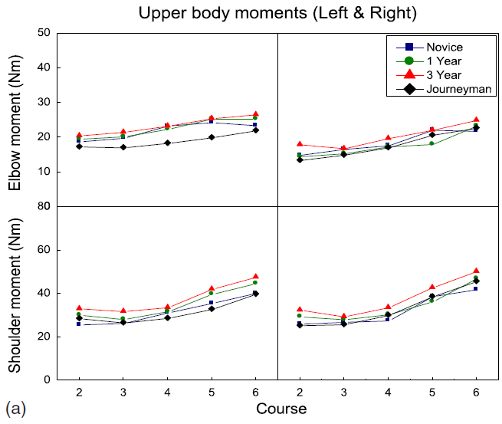
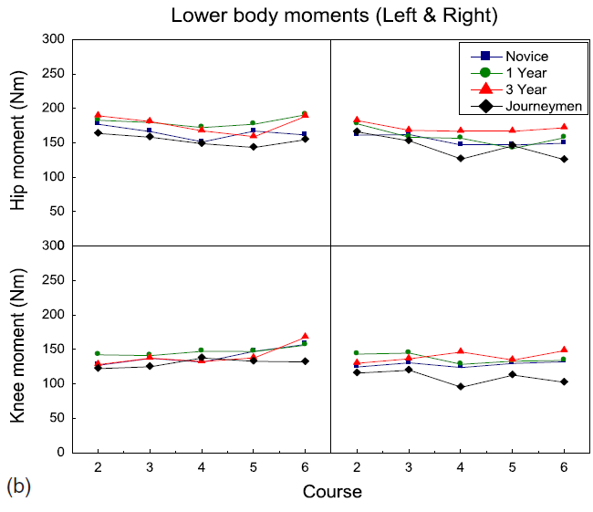
Analysis of Relationships between Body Load and Training, Work Methods, and Work Rate
Moment of upper body has increasing trend

Slide 19
Analysis of Relationships between Body Load and Training, Work Methods, and Work Rate
Problem Statement: How does experience workers load their joints and adjust their posture to work more safely and more efficiently compared to apprentices
Novice
Safety
1-year experience
IMU+3DSPP
Lift Type
Hypothesis Test
3-year experience
Journeyman
Efficiency
Conclusion: Repeatedly lowering down the back without carrying heavy loads is also harmful Safer and more productive to work with the assistance of machine

Slide 20
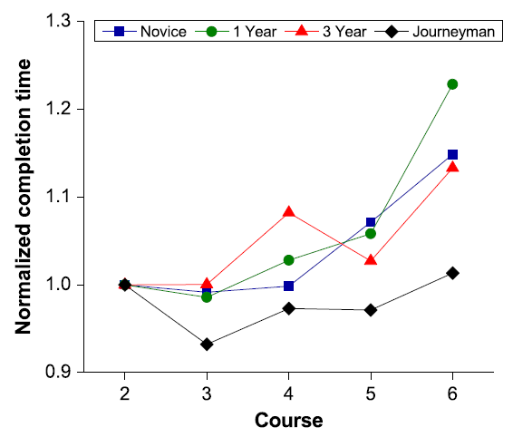
Analysis of Relationships between Body Load and Training, Work Methods, and Work Rate
Journeyman has shortest completion time

Slide 21
Analysis of Relationships between Body Load and Training, Work Methods, and Work Rate
Problem Statement: How does experience workers load their joints and adjust their posture to work more safely and more efficiently compared to apprentices
Novice
Safety
1-year experience
IMU+3DSPP
Lift Type
Hypothesis Test
3-year experience
Journeyman
Efficiency
Conclusion: Repeatedly lowering down the back without carrying heavy loads is also harmful Safer and more productive to work with the assistance of machine

Slide 22
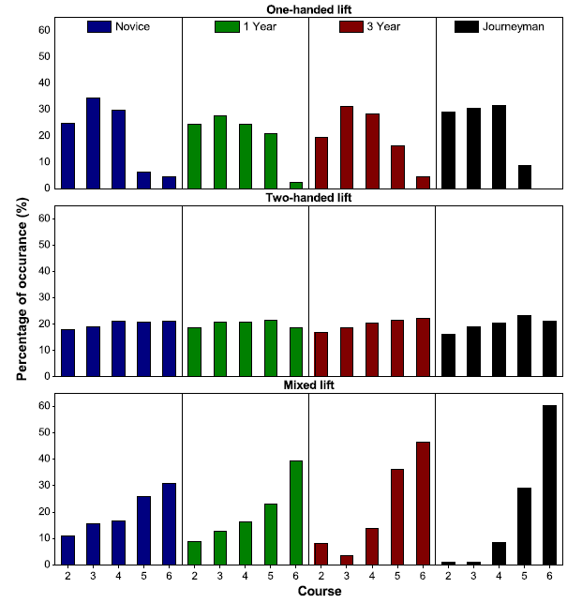
Analysis of Relationships between Body Load and Training, Work Methods, and Work Rate
Journeyman mostly used mixed lift at course 6 to reduce lumbar compression force

Slide 23
Analysis of Relationships between Body Load and Training, Work Methods, and Work Rate
Problem Statement: How does experience workers load their joints and adjust their posture to work more safely and more efficiently compared to apprentices
Novice
Safety
1-year experience
IMU+3DSPP
Lift Type
Hypothesis Test
3-year experience
Journeyman
Efficiency
Conclusion: Repeatedly lowering down the back without carrying heavy loads is also harmful Safer and more productive to work with the assistance of machine

Slide 24
Analysis of Relationships between Body Load and Training, Work Methods, and Work Rate
Time(hr)
Time(hr)
10
10.5
5
5.5
A
B
A
B
Hypothesis: Drug A averagely takes 5 hours less than Drug B to cure a disease
Conclusion: Red Population has similar mean value as Blue Population, hence fail to reject the hypothesis

Slide 25
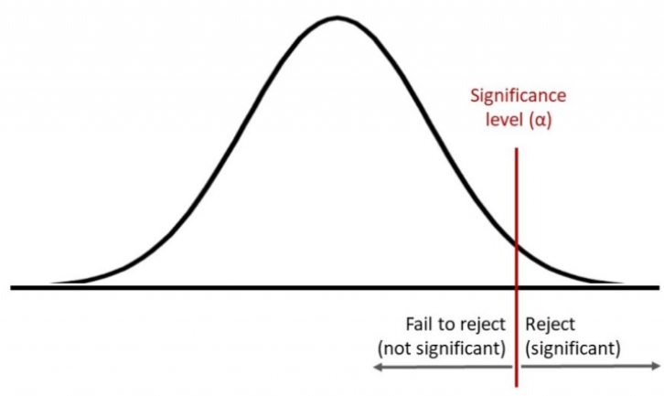
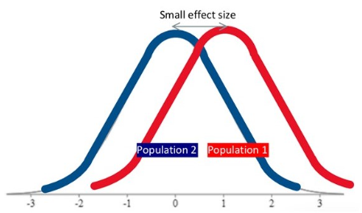
Analysis of Relationships between Body Load and Training, Work Methods, and Work Rate

Slide 26
Challenges of This Week
To understand more deeply about the biomechanics of the body part, I tried to briefly understand how the muscles, tendons, and bones combine together
When review back to my framework, I realised the way they calculate the stress is not exactly what I understand, need to consider the contribution of muscles as well.

Slide 27
Next Meeting
Keep reading the papers left
Start trying to extract the coordinates using OpenPose
Reframe the framework with limited data and review the papers
Proposal for RGBD camera

